Slide 1
Plural of nouns
Презентация выполнена учителем Костыренковой Л.Н., МОАУ «СОШ№51 г.Орска»

Slide 2
A noun is a word that functions as the name of something. Nouns are the most common class of word in English
Types of Nouns
Proper nouns are the names of specific things, people, or places, such as Jane, France. They begin with a capital letter.
Common nouns are general names such as person, mansion, and book. They can be either concrete or abstract.
Concrete nouns refer to things which you can sense such as clock and telephone.
Abstract nouns refer to ideas or qualities such as liberty and truth.
Countable nouns refer to things which can be counted (can be singular or plural)
Uncountable nouns refer to some groups of countable nouns, substances, feelings and types of activity (can only be singular

Slide 3
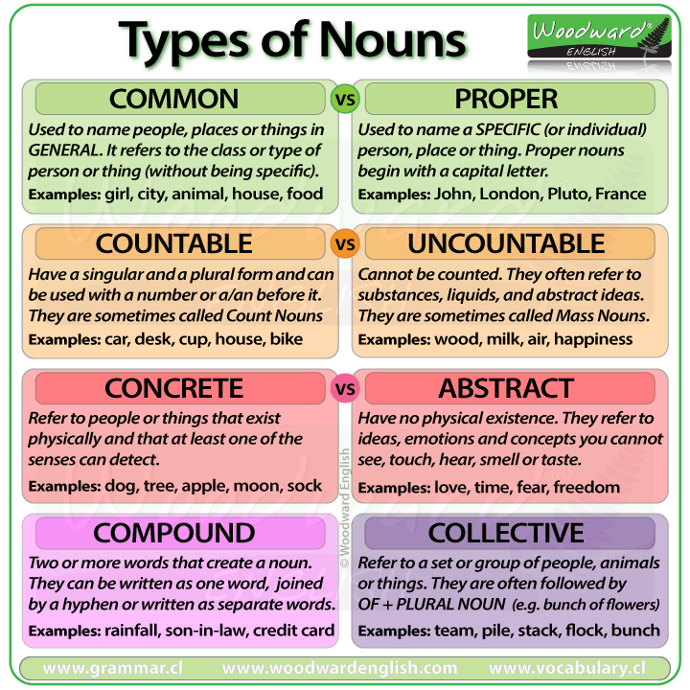

Slide 4
A noun is a word used to refer to people, animals, objects, substances, states, events and feelings. Nouns can be a subject or an object of a verb, can be modified by an adjective and can take an article or determiner.
The general rule is to add "-s" to the noun in singular.
Book - Books
House - Houses
Chair - Chairs
When the singular noun ends in: -sh, -ch, -s, -ss, -x, -o we form their plural form by adding "-es".
sandwich - sandwiches
brush - brushes
bus - buses
When the singular noun ends in "y", we change the "y" for "i" and then add "-es" to form the plural form. But do not change the "y" for "ies" to form the plural when the singular noun ends in "y" preceded by a vowel.
Family – families
day - days

Slide 5
Other Plural FoRms and Compaund nouns.
1) Nouns ending in O.
Negroes, heroes, potatoes, tomatoes.
BUT MIND
Pianos, sopranos, radios, photos, zeros, zoos.
2)Nouns ending in f or fe. The final letter or letters are dropped and ves is added.
Knives, lives, wives, shelves.
BUT MIND
gulfs, safes, beliefs, roofs, chiefs.
COMPOUND NOUNS
1)Non-hyphenated: the last word is used in the plural.
Schoolboy-schoolboys
Postman-postmen
2) Hyphenated: the main meaningful word is used in the plural.
Mother-in-law – mothers-in law passer-by- passers-by
3)If the first word of the compound is woman or man both the words are used in the plural.
Woman-doctor – women-doctors man- servant – men -servants

Slide 6
Irregular nouns
a man- men
A woman- women
A child-children
A tooth-teeth
A goose-geese
A mouse-mice
A foot-feet

Slide 7
Nouns from Latin and Greek retain their original plural form.
Crisis-crises
Analysis-analyses
Axis-axes
Datum-data
Criterion-criteria
Phenomenon-phenomena
Radius-radii
Stimulus-stimuli
Thesis-theses
Parenthesis-parentheses
Hypothesis- hypotheses
Medium-media

Slide 8
Nouns which are used with a verb in singular.
Weather
Furniture
Information
Advice
News
Money
Knowledge
Progress
Hair
Work
Watch
time

Slide 9
Nouns which are used with a verb in plural.
Wages
Police
Trousers
Spectacles
Scales
Suburbs
Clothes
Goods
Politics

Slide 10
Groups of words which are used with a verb in singular.
1) Bacon and eggs/port and beans-as one dish.
2)One of…, neither of…,nobody.
3)My father, as well as two of his friends, was invited to…

